Slide 1
Orientation and Introduction to the Ancient World -TransAnatolie
Kenneth Harl, Ph.D. Professor of Classical History at Tulane University in New Orleans. An expert on classical Anatolia.

Slide 2
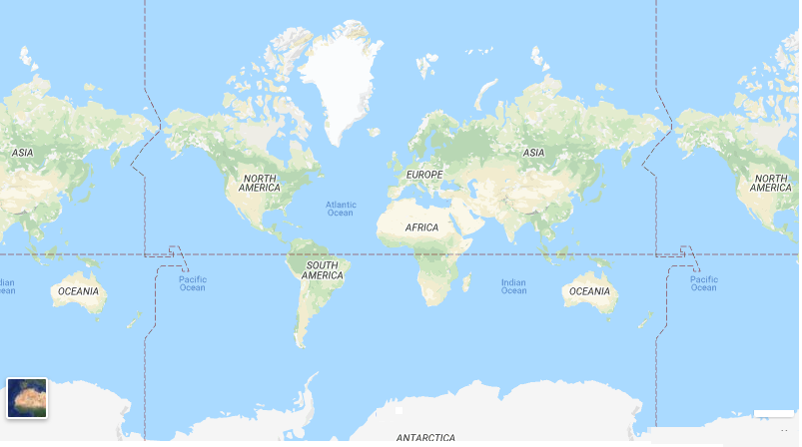

Slide 3
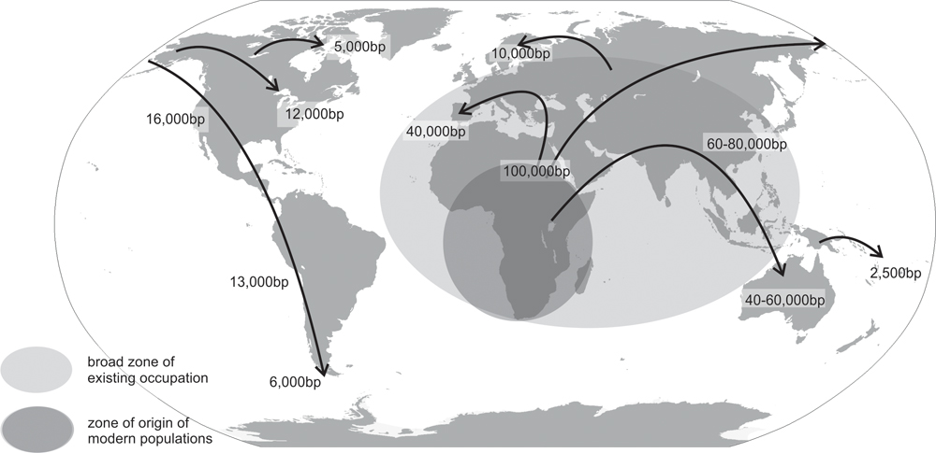

Slide 4
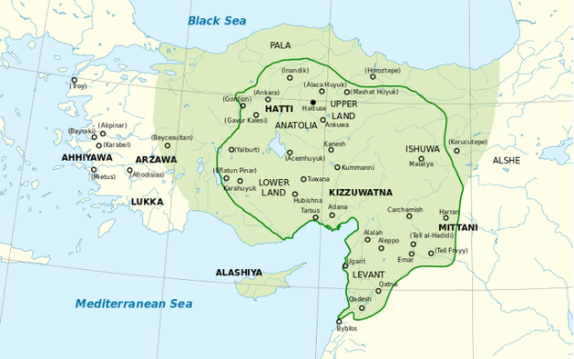

Slide 5
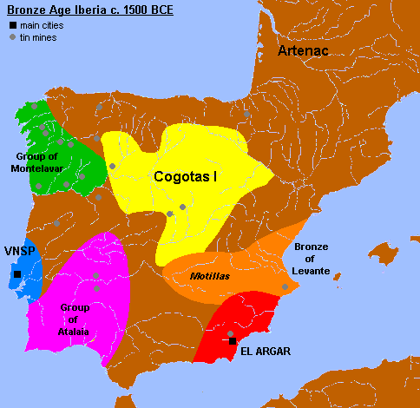

Slide 6
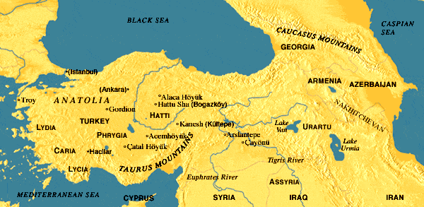

Slide 14
